Slide 1
Transmission
Control Protocol
(TCP)

Slide 2
TCP SERVICES
Stream Delivery Service
Full –Duplex Communication
Connection-Oriented Service
Reliable Service

Slide 3

Process to Process Communication
Stream delivery

Slide 4

Sending and receiving buffers

Slide 5

TCP segments

Slide 6
NUMBERING
BYTES

Slide 7

The bytes of data being transferred
in each connection are numbered by TCP.
The numbering starts with
a randomly generated number.

Slide 8
Example 1
Imagine a TCP connection is transferring a file
of 6000 bytes. The first byte is numbered 10010.
What are the sequence numbers for each segment if data is sent in five segments with the first four segments carrying 1,000 bytes and the last segment carrying 2,000 bytes?

Slide 9
Solution
The following shows the sequence number for each segment:
Segment 1 ➔10,010 (10,010 to 11,009)
Segment 2 ➔11,010 (11,010 to 12,009)
Segment 3 ➔12,010 (12,010 to 13,009)
Segment 4 ➔13,010 (13,010 to 14,009)
Segment 5 ➔ 14,010 (14,010 to 16,009)

Slide 10
The value of the sequence number field in
a segment defines the number
of the first data byte
contained in that segment.

Slide 11
The value of the acknowledgment field in a
segment defines the number of the
next byte a party expects to receives.
The acknowledgment number is cumulative.

Slide 12
SEGMENT

Slide 13

TCP segment format

Slide 14


Description of flags in the control field

Slide 15
CONNECTION

Slide 16

Figure 12-28
Three-way handshaking

Slide 17
A SYN segment cannot carry data, but it consumes one sequence number.
A SYN + ACK segment cannot carry data, but does consume one sequence number.
An ACK segment, if carrying no data, consumes no sequence number.

Slide 18

Data Transfer

Slide 19

Connection termination

Slide 20
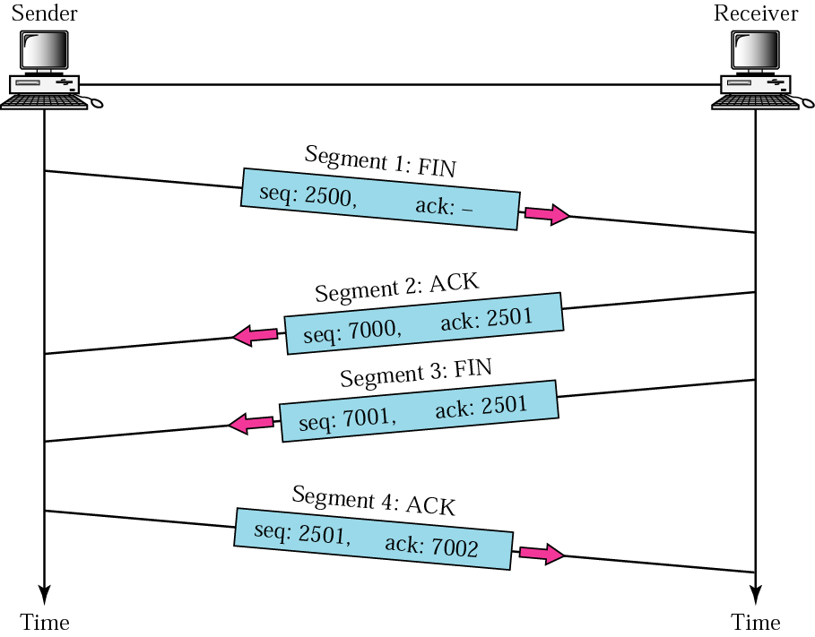
Figure 12-29
Four-way handshaking

Slide 21
FLOW
CONTROL

Slide 22

Sliding Window
A sliding window is used to make
transmission more
efficient as well as to control the flow of
data so that the destination
does not become overwhelmed with data.
TCP’s sliding windows are byte oriented.

Slide 23
Example 23.4
What is the value of the receiver window (rwnd) for host A if the receiver, host B, has a buffer size of 5000 bytes and 1000 bytes of received and unprocessed data?
Solution
The value of rwnd = 5000 − 1000 = 4000. Host B can receive only 4000 bytes of data before overflowing its buffer. Host B advertises this value in its next segment to A.
23.<number>

Slide 24
Example 23.5
What is the size of the window for host A if the value of rwnd is 3000 bytes and the value of cwnd is 3500 bytes?
Solution
The size of the window is the smaller of rwnd and cwnd, which is 3000 bytes.
23.<number>

Slide 25
Some points about TCP sliding windows:
❏ The size of the window is the lesser of rwnd and
cwnd.
❏ The source does not have to send a full window’s
worth of data.
❏ The window can be opened or closed by the receiver, but
should not be shrunk.
❏ The destination can send an acknowledgment at any time
as long as it does not result in a shrinking window.
❏ The receiver can temporarily shut down the window; the
sender, however, can always send a segment of 1 byte
after the window is shut down.
23.<number>

Slide 26
ERROR
CONTROL

Slide 27
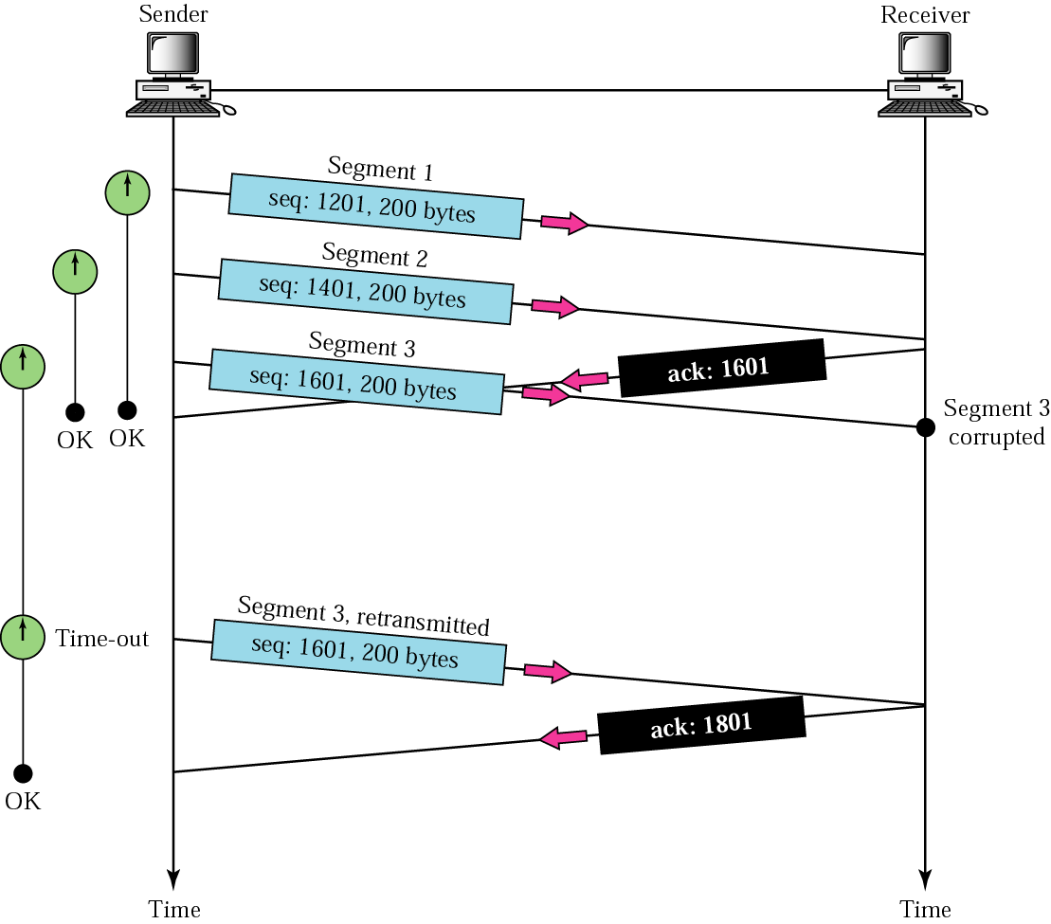
Figure 12-13
Corrupted segment

Slide 28
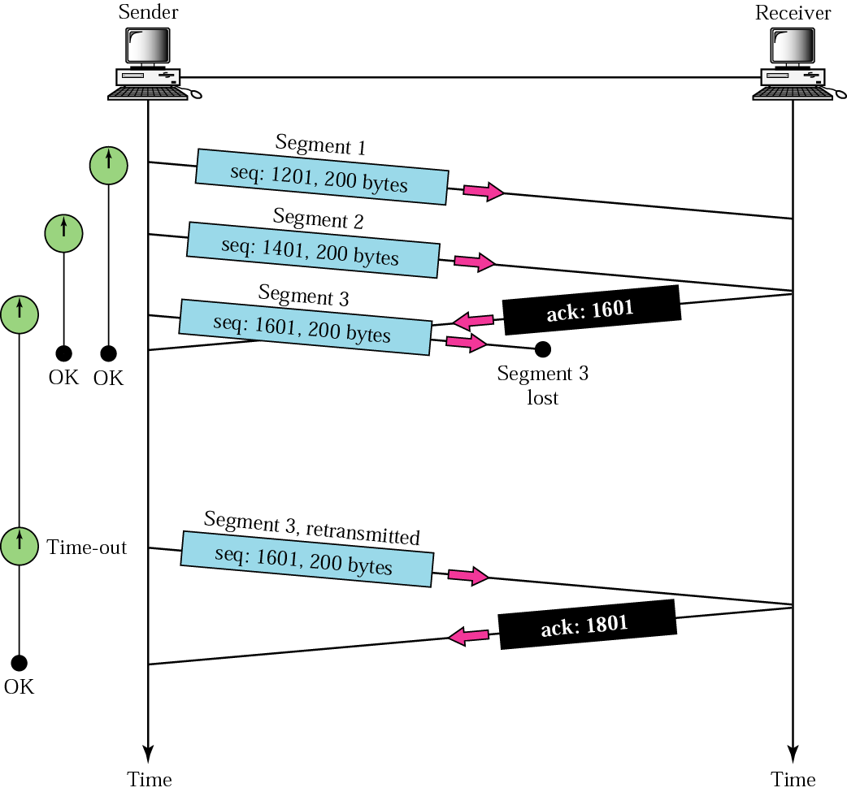
Figure 12-14
Lost segment

Slide 29
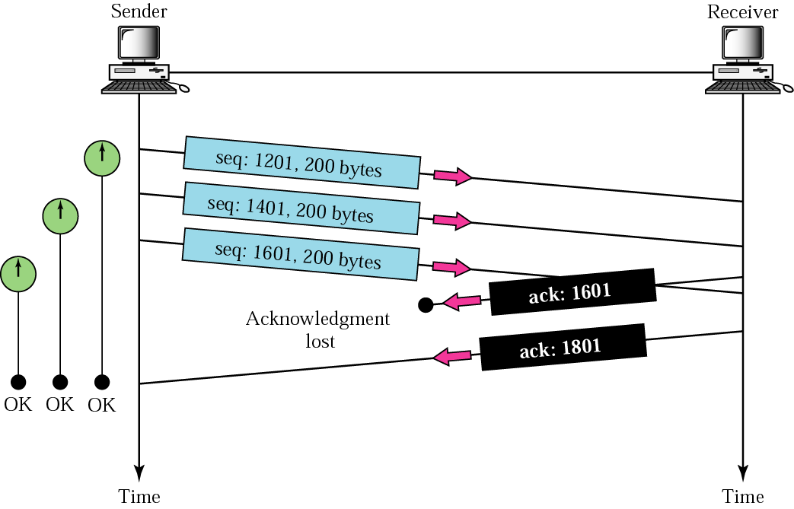
Figure 12-15
Lost acknowledgment

